Slide 1
And, But, Or
Connecting words and sentences using conjunctions.

Slide 2
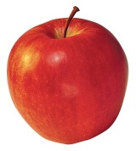
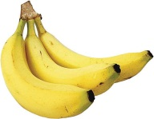
AND
We use ‘and’ when we want to add something to something else.
For example:
bananas and an apple
I have a bag and a hat .
The kids are having a party and they are happy .

Slide 3
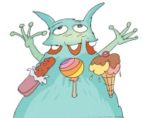
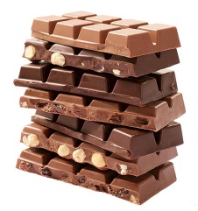
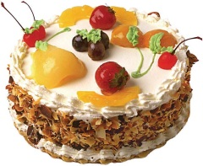
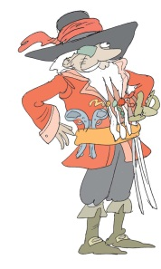
BUT
We use ‘but’ when we want to show two opposite things.
For example:
The monster looks scary but it is gentle.
I like chocolate but I don’t like cake.
The pirate wants the treasure but he doesn’t know where it is.

Slide 4
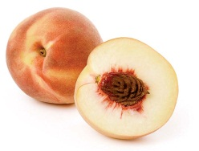
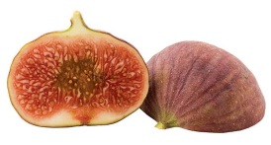
Or
We use ‘or’ when we have a choice between two things.
For example:
this one or that one
I don’t like figs or peaches.
I can go on a pirate ship or I can go on a hot-air balloon.

Slide 5
Let’s sing
Go to this video clip
Watch the video a few times.
The song is about ‘and’, ‘but’ and ‘or’.
The song is called ‘Conjunction Junction’.
And, but and or are all conjunctions because they join words and sentences.
Sing along when you feel ready.
Then go on to do the exercise on the next slide.

Slide 6
Now you try.
Add ‘and’, ‘but’, ‘or’ to each pair of sentences.
I can walk to school _______ I can’t fly to school.
I can take a bus to school _______ I can ride my bike.
We study English _______ History in school.
Pirates look mean _______ they can be very nice.
We can eat hot dogs _______ pizza, but not both.
Henry and Lucy can fly _______ help people with the magic stardust.
Lucy likes apple cake very much _______ she doesn’t like banana cake.

Slide 7
Answer sheet
Add ‘and’, ‘but’, ‘or’ to each pair of sentences.
I can walk to school but I can’t fly to school.
I can take a bus to school or I can ride my bike.
We study English and History in school.
Pirates look mean but they can be very nice.
We can eat hot dogs or pizza, but not both.
Henry and Lucy can fly and help people with the magic stardust.
Lucy likes apple cake very much but she doesn’t like banana cake.

Slide 8
Tg
Go over the different conjunctions with the class, explaining each one using the examples.
Ask for more examples from the students while explaining.
When you have explained all three, have them watch and listen to the song ‘Conjunction Junction’.
Encourage them to sing along.
After they have watched, have them do the exercise on slide 6.

